Slide 1
SQL Server Failover Effects on Applications
Author: James A. Tweet
Supervisor: Prof. Mock, PhD

Slide 2
Project Goals
Build a SQL Server Cluster
Understand how to use a SQL Server cluster
Test the effects of a failover event on
ADO.NET
DAO
JDBC
Get a SQL Server Certification

Slide 3
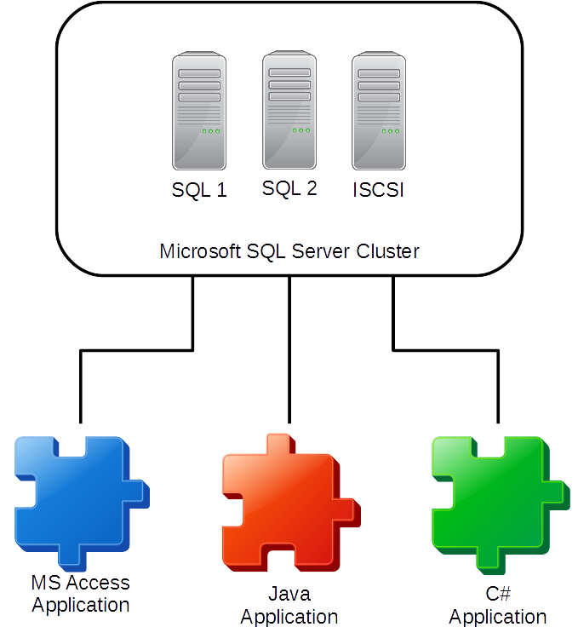

Slide 4
Build the Cluster
Setup two virtual PCs with Windows 2012.
Setup a virtual PC as a ISCSI target
Create the cluster between the two Windows PCs
Install SQL Server on the cluster
Test the cluster for proper operation

Slide 5
Understand the Cluster
How do I
Failover the cluster
Connect to SQL Server
Default Instance
Named Instance
Where can backup files go
Notifications/Events when failover occurs

Slide 6
Build the Software
Create three databases on the SQL Server
Create a MS Access application
Create a Java application
Create a C# application

Slide 7
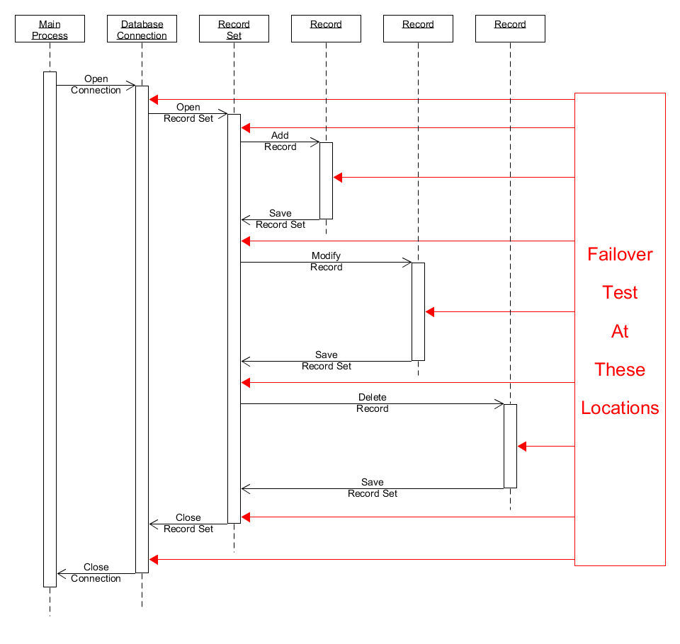

Slide 8
Modify the Software
Change the applications to handle failover events
Change the applications to notify the user that they must close and restart the application

Slide 9

Exam 70-462 Administering Microsoft SQL Server 2012 Databases

Slide 10
Questions
?

